Slide 1
SAURUSS
Smart
Autonomous
UAV
Recognizer for
Universal
Surveillance
System

Slide 2
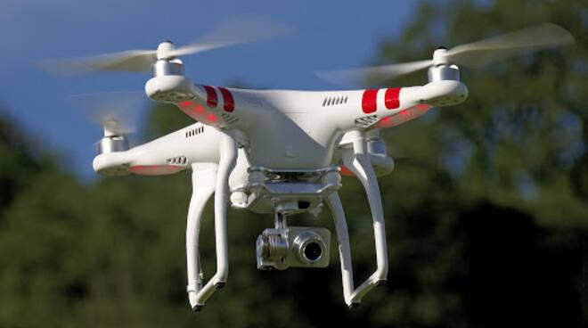
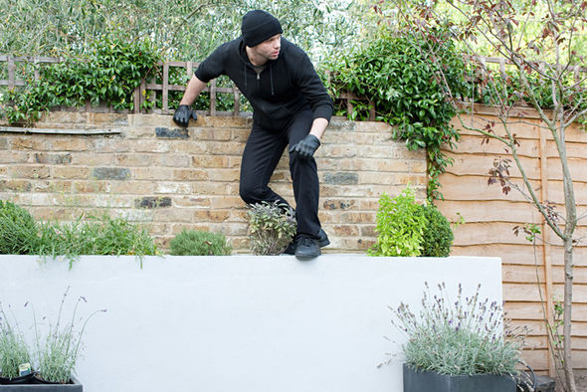
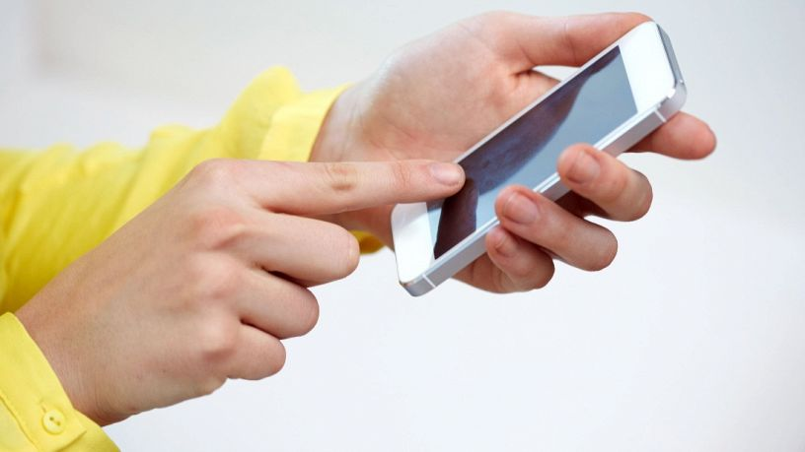

Slide 3
Our System
SAURUSS consist of:
our bridge that does all the heavy lifting for image processing and person detection
our drone, equipped with a camera, connected wirelessly to the bridge
our sensors, with bluetooth connection to our bridge

Slide 4
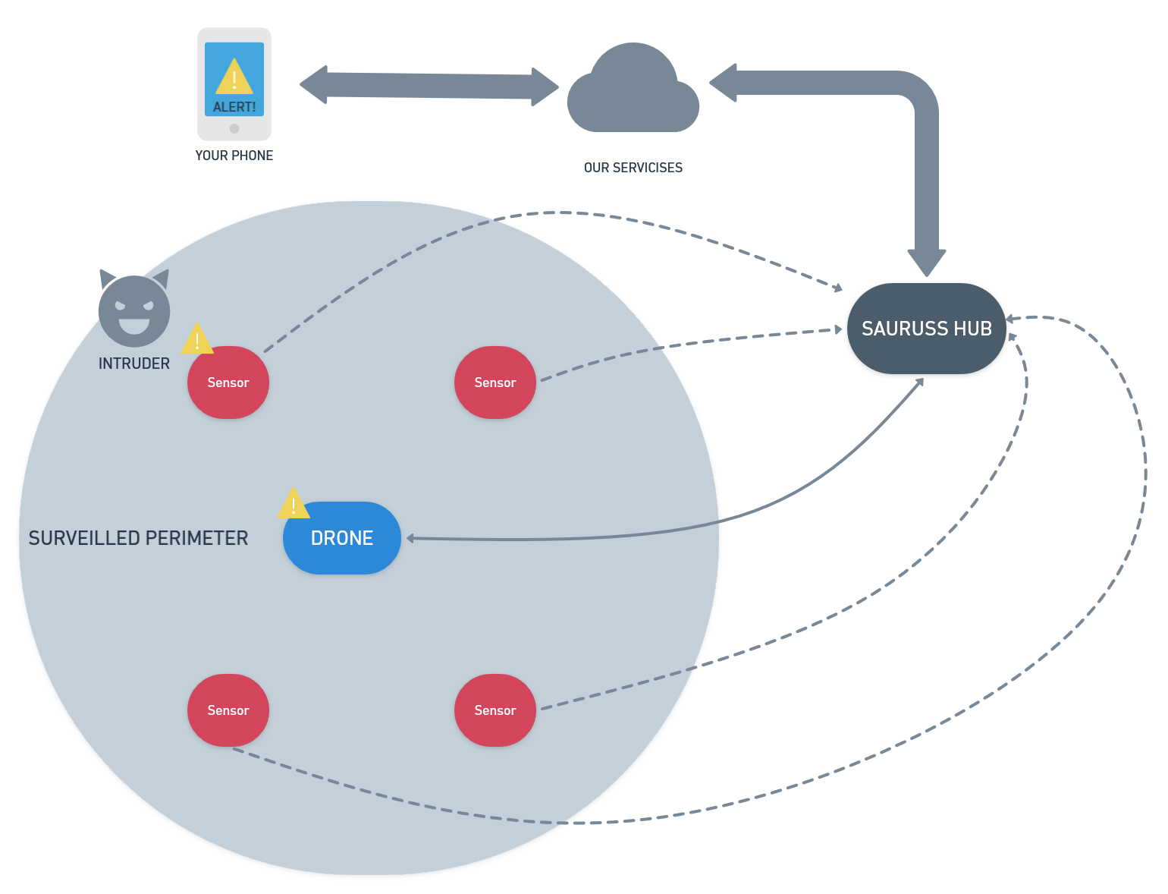
How it Works?
If our sensors sense an intruder inside the surveilled perimeter, our drone will fly towards it.
Our smart hub will tell if there is someone and notify you, through our app, with a pic and video proof! 📸

Slide 5
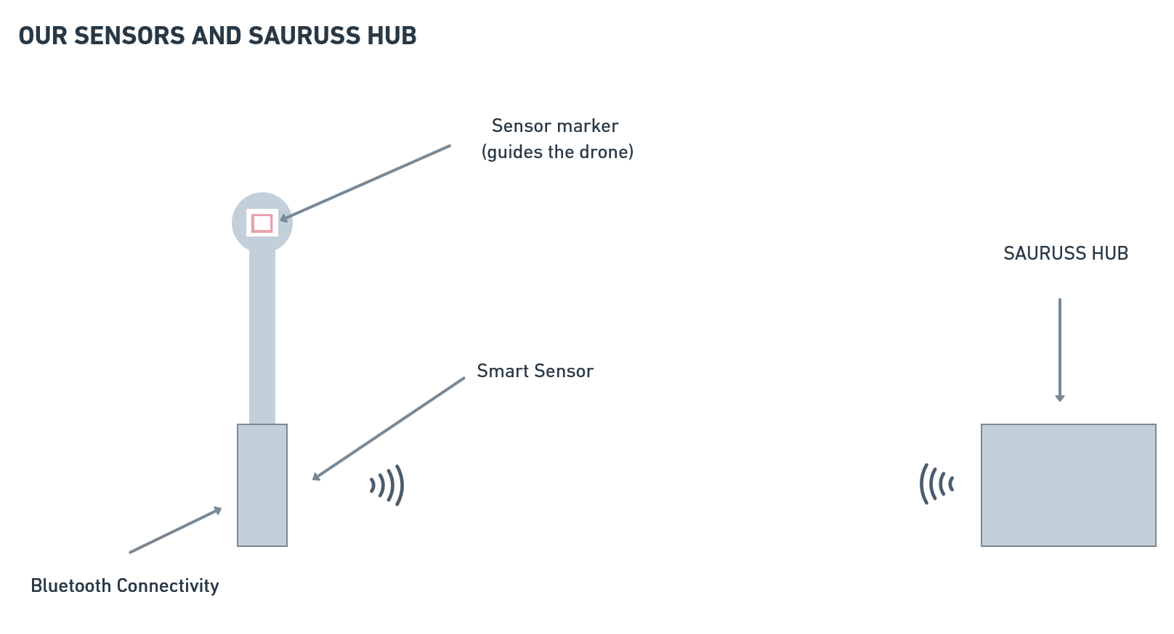


Slide 6
HW & SW used for our 3D System 🔎

Slide 7



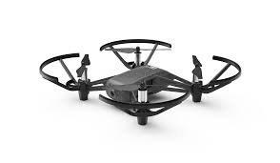
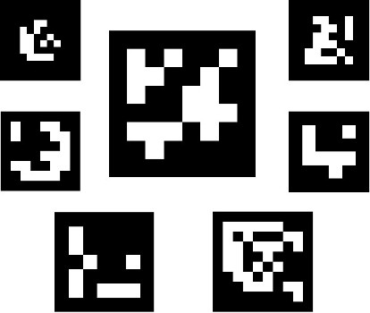

ArUco library

Slide 8
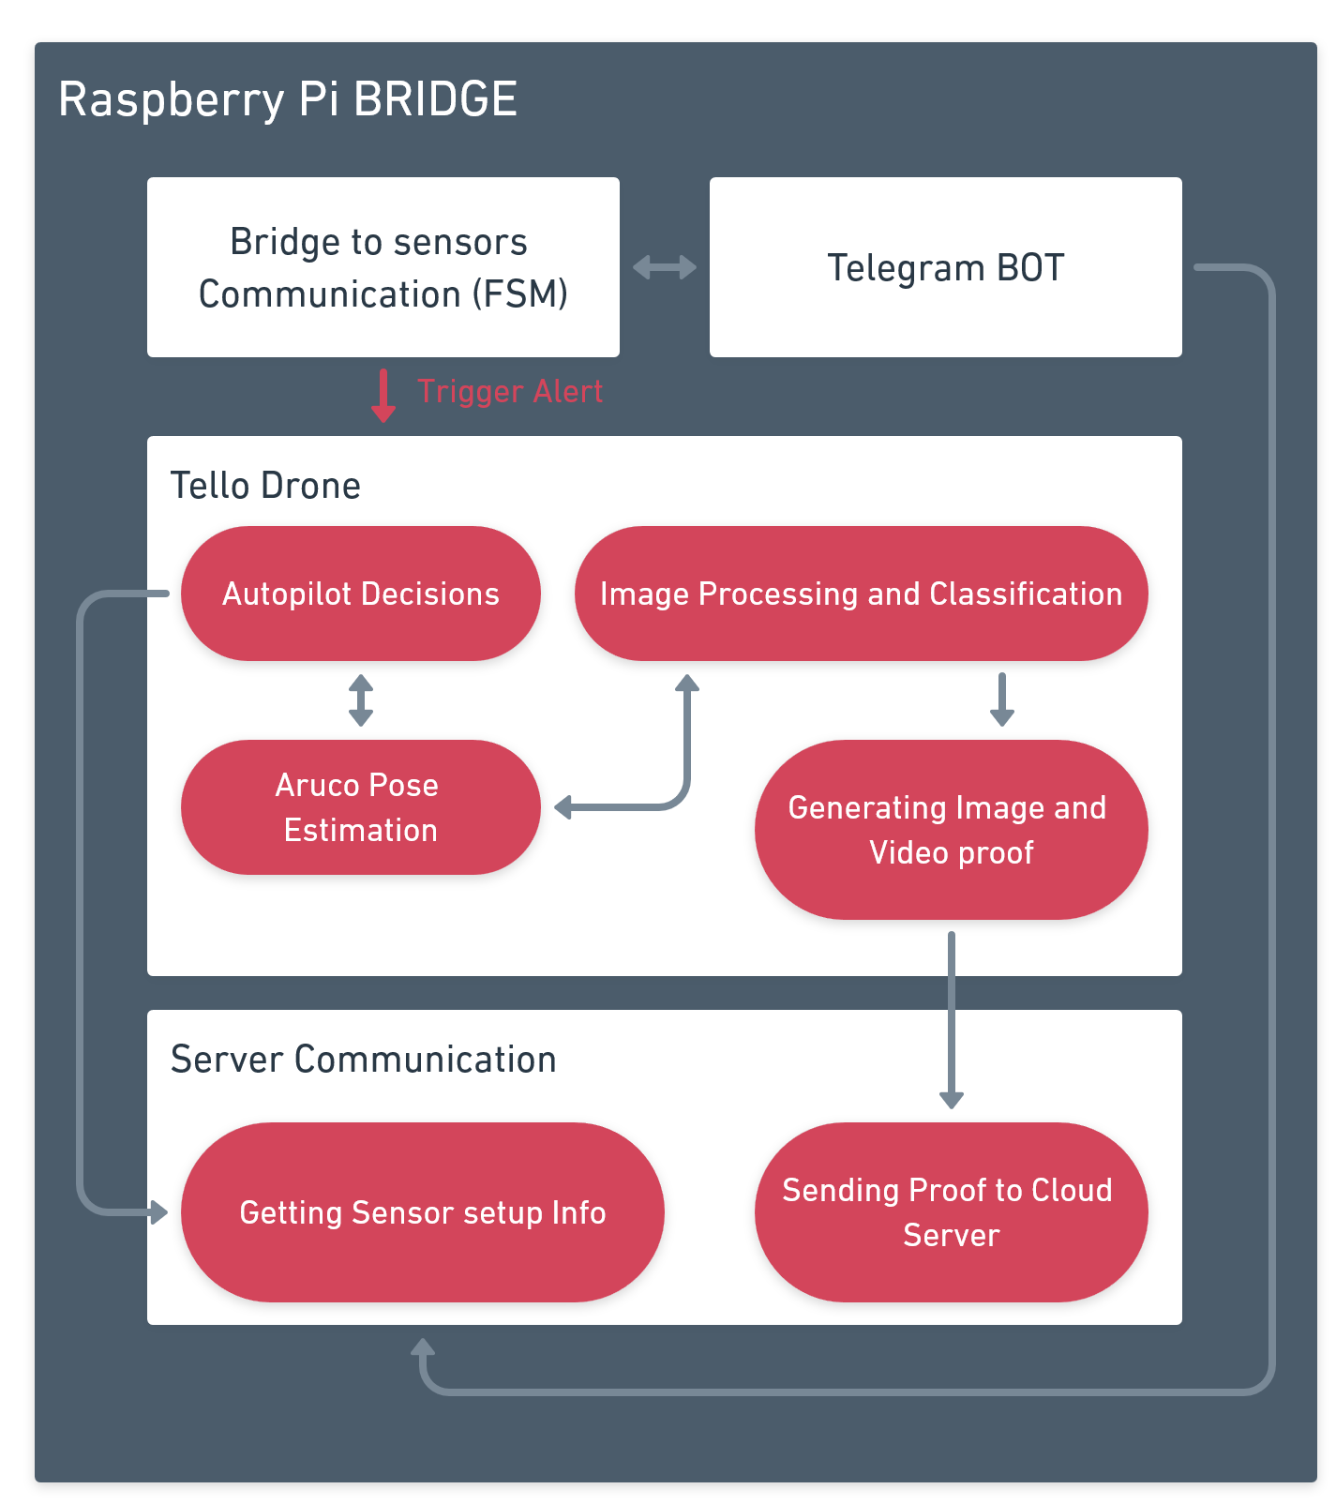
Raspberry Pi bridge
Bridge is the center of the drone’s decisions and also of the frame elaboration done by the camera
Visual and Object recognition activities are based on AI algorithms (OpenCV and YOLO)
When the drone sees a human, an alarm is set off by the bridge

Slide 9
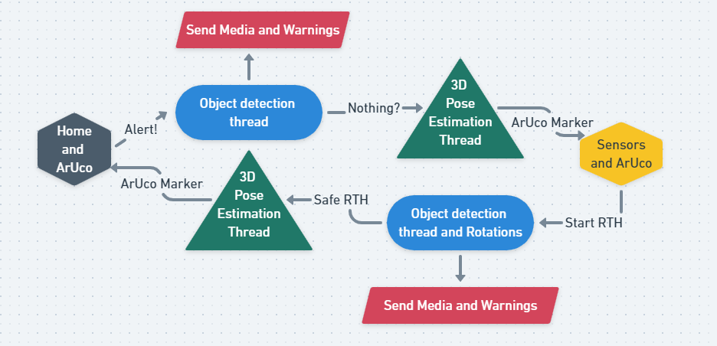
Graphic description

Slide 10
Drone Autonomous Driving & use of ArUco markers 🔲

Slide 11
How to help the drone go where it needs to?
PROBLEMS
No GPS in our drone
Low accuracy in move commands
Low accuracy for RTH (Return to Home)
SOLUTION
Use of ArUCO markers for improving drones self-driving algorithm!

Slide 12
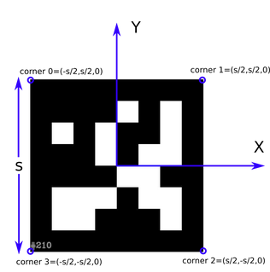
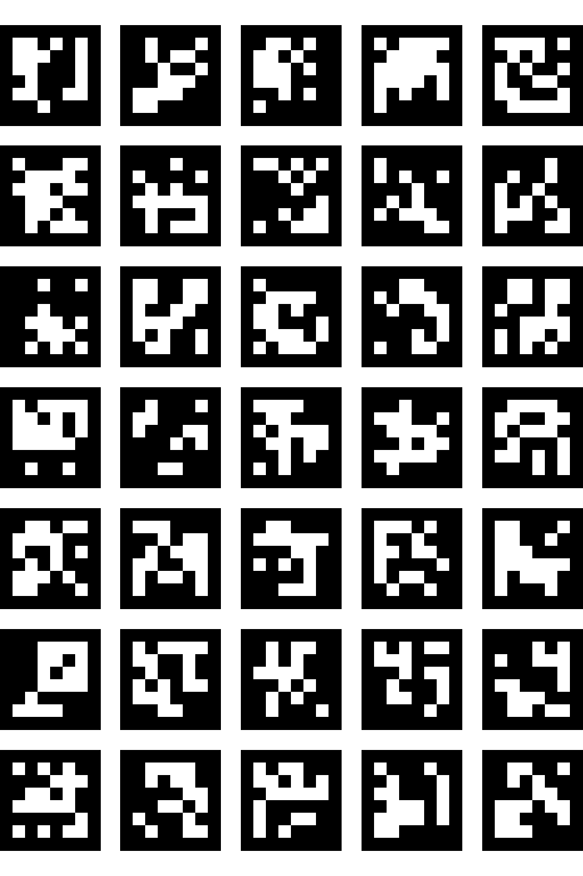
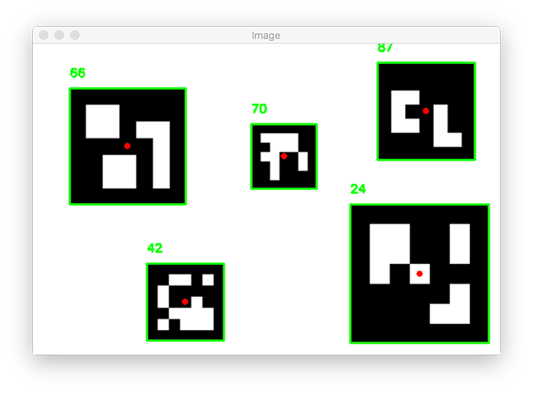
What are ArUCO Markers?
ArUco is a popular library that uses binary square fiducial markers for pose estimation in computer vision applications
A single marker provides 4 corners to achieve camera pose
Robust Internal binary coding, for possible implementations of error detection techniques.
Once a dictionary is chosen, each ArUco marker has its own ID

Slide 13
Our Algorithm - Pseudo Code 1
corners, ids, rejected = aruco.detectMarkers(image, dictionary, parameters, cameraMatrix, distCoeff)
cameraMatrix and distCoeff are used because our drone camera is not ideal (more on this later) and has intrinsic parameters useful for image processing
The functions return an array of array with the identified ArUco markers corners in the scene
ret = aruco.estimatePoseSingleMarkers(corners, marker_size, parameters,cameraMatrix, distCoeff)
The functions return an array of array (ret) where, for each ArUco marker found, there is a rotation vector rvec and translation vector tvec inside (more on this later)
rvec and tvec have 3 components each (one for each axis in the three dimensional space)

Slide 14
Our Algorithm - Pseudo Code 2
R_ct = np.matrix(cv2.Rodrigues(rvec))
roll_marker, pitch_marker, yaw_marker = rotationMatrixtoEulerAngles(R_ct)
With the first function we obtained the Rotation matrix (R_ct)of the ArUco tag with respect to the camera
In the second function we obtained the roll, pitch and yaw of the markers with respect to the camera →We now can compute useful informations for our self-driving algorithm!
For our self-driving drone we only need:
Distance along z-axis (tvec[0])
Marker yaw and pitch respect to camera
Center position of the marker C = (X,Y) (we use the corners pixel position)

Slide 15
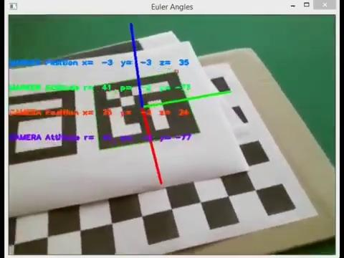
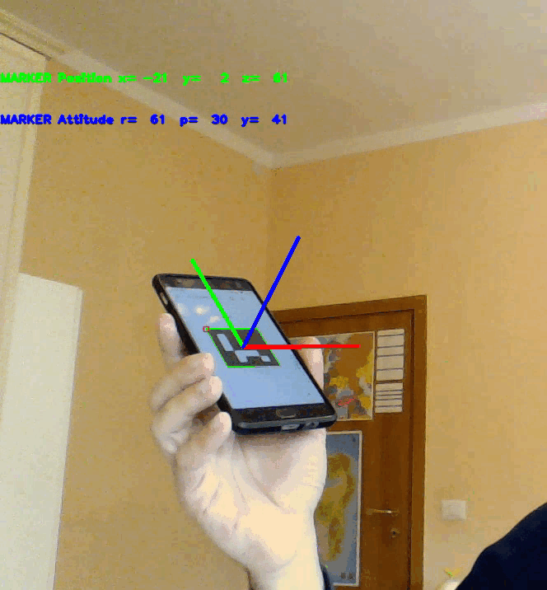
ArUco marker pose estimation

Slide 16
A look under the hood 🧐
understanding
pose estimation…
...and it’s challenges

Slide 17
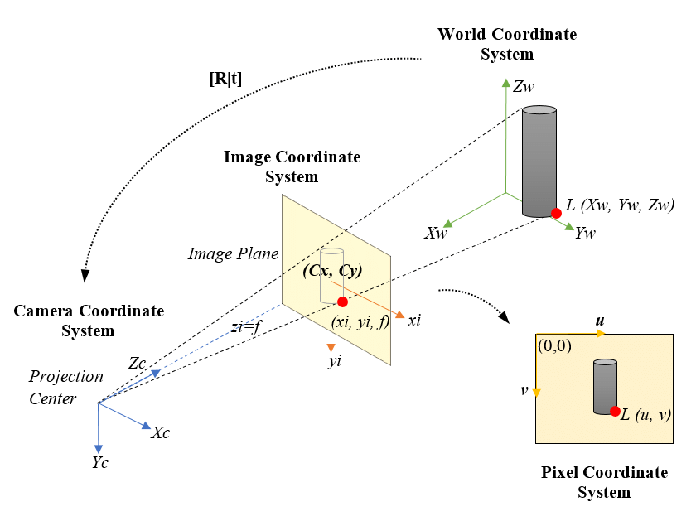
Pinhole camera model
The pinhole camera model describes the mathematical relationship between the coordinates of a point in three-dimensional space and its projection onto the image plane of an ideal pinhole camera, where the aperture of the camera is described as a point and no lenses are used to focus the light.

Slide 18
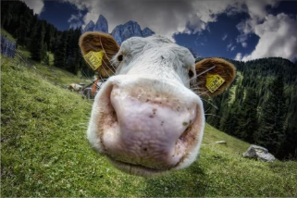
Distortion problem
The ideal pinhole camera model does not include, for example, geometric distortions or blurring of objects caused by lenses and apertures of finite size.

Slide 19
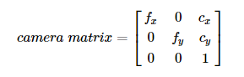
Solution: Camera Calibration
Calibration is necessary in order to derive the intrinsic parameters of the camera, such as:
Distortion of the image
Focal length
Optical center

Slide 20
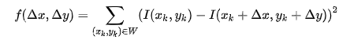
Harris Corner Detector
Thanks to Harris corner detection algorithm it’s possible to get the intersection of an angle in an image “I” in a window “W”
Where (dx, dy) is the shift of the point (x,y)

Slide 21
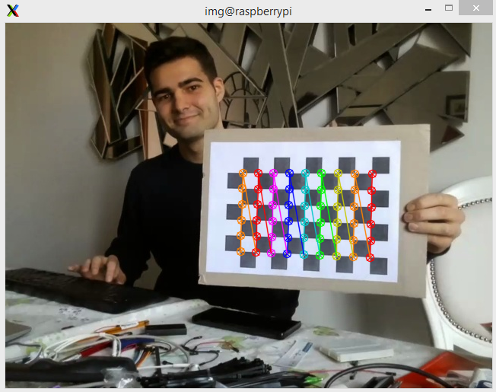
Chessboard calibration
The calibration of the drone camera was done using a 9x6 chessboard (number of intersections between chess).

Slide 22
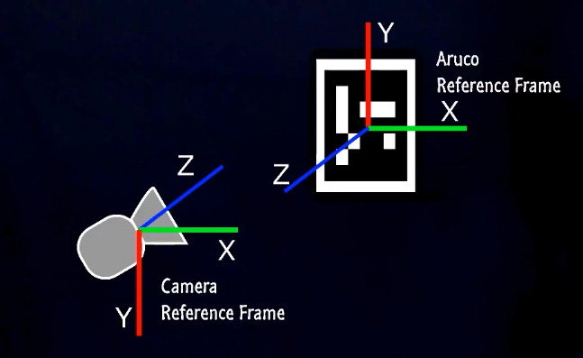
Camera and Marker Pose estimation problem
PROBLEM
We have two reference systems: one for the drone camera, one for the ArUco marker
We need to get the pose of the drone camera with respect to the marker
SOLUTION
We do that with the estimatePoseSingleMarkers OpenCV function and we obtain:
the rotation vector (rvec) - rotation of marker respect to the camera (Rodrigues notation)
the translation vector (tvec) - position of marker respect to the camera

Slide 23
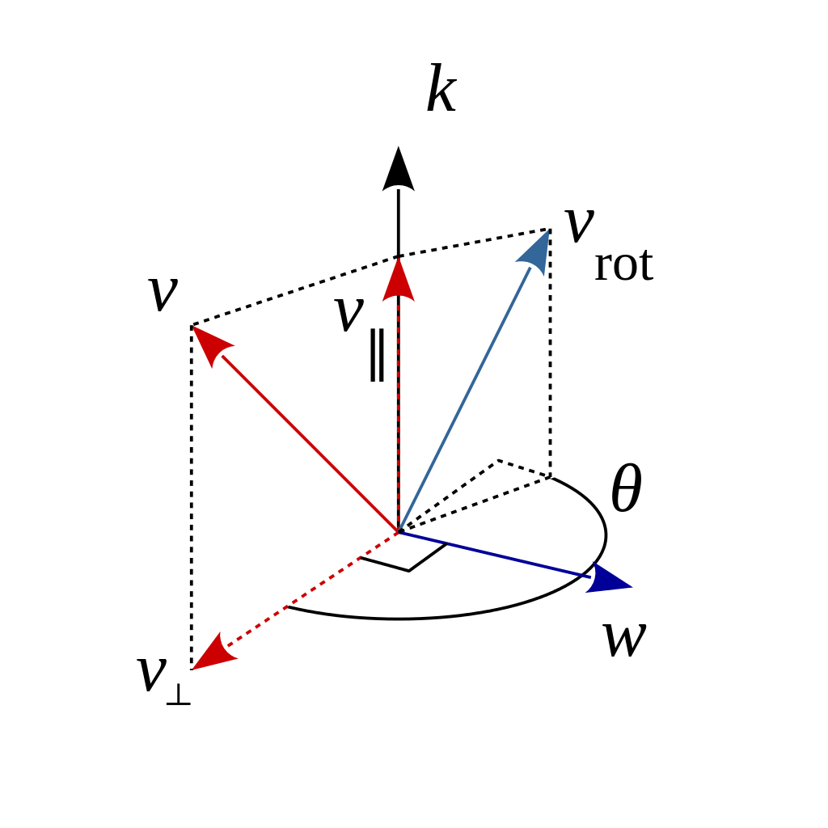
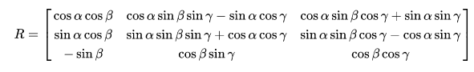
Calculating the Camera-to-Marker Rotation Matrix
But we actually need the Rotation Matrix R_ct from marker to camera for computing the yaw, pitch and roll of the marker to camera and vice versa
Thankfully, OpenCV helps us with the function cv2.Rodrigues(rvec) that returns the R_ct matrix (more info are available in the OpenCV online documentation here)
rvec[0] = rx
rvec[1] = ry
rvec[2] = rz

Slide 24
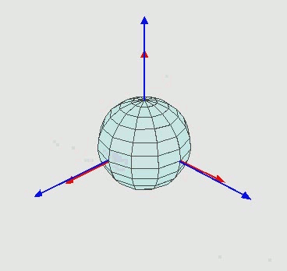
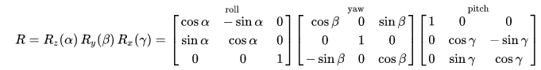
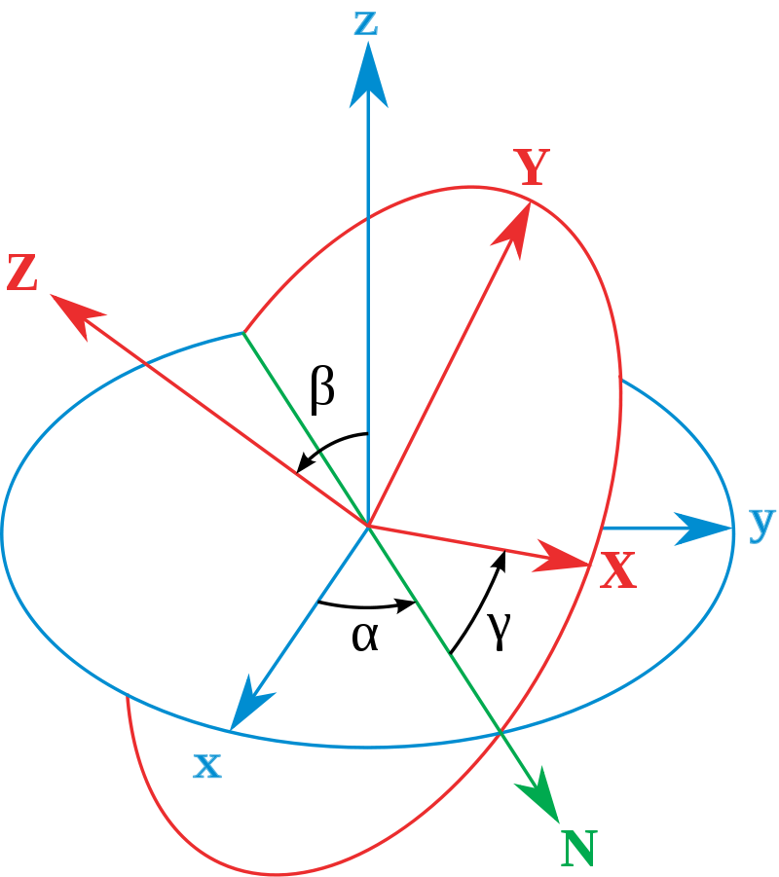
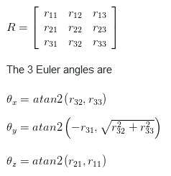
Calculating Roll - Pitch - Yaw from Rotation Matrix
Rotation Matrix to Euler Angles formula
θ_{X} → Roll
θ_{Y} → Pitch
θ_{Z} → Yaw

Slide 25
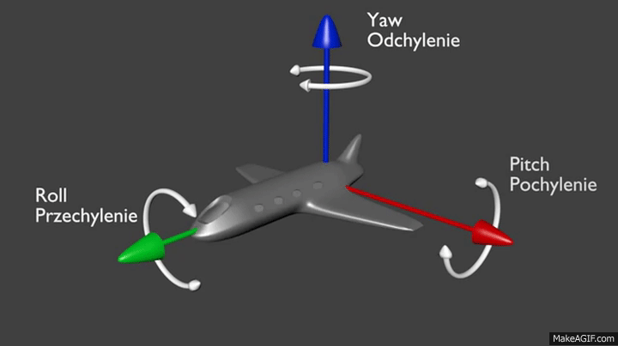
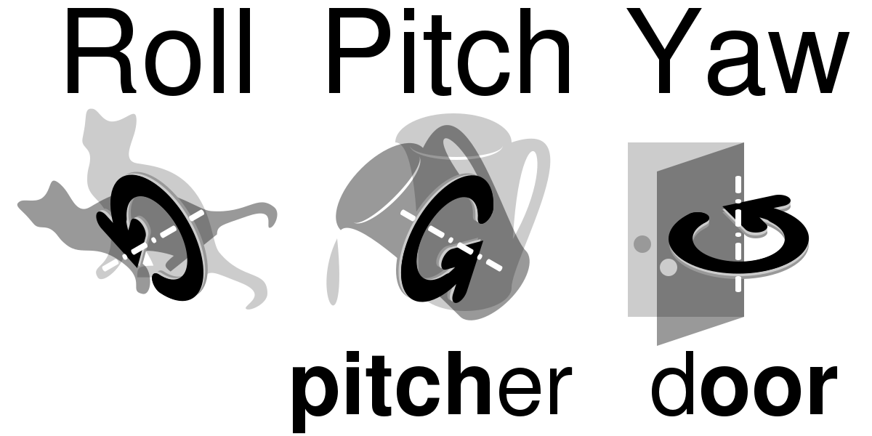

Slide 26
Telling the drone what to do:
Tello SDK 2.0
Once we obtained the roll, pitch, yaw and the distance between the drone camera and the marker, we need to interact with the drone with the following elementary functions:
tello.move(dir, dist)
tello.go(x,y,z,speed)
tello.rotate_counter/clockwise(theta)
tello.takeoff()
tello.land()
with tello.get_time_of_flight() you can estimate the distance traveled. but it’s not accurate for environmental agents.

Slide 27
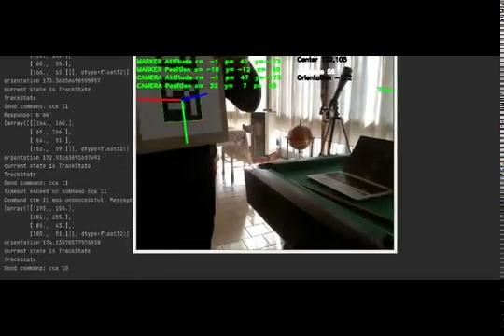
Tello drone pose estimation and tracking

Slide 28
Drone Object Recognition &
YOLO 👀

Slide 29

What a CNN is

Slide 30
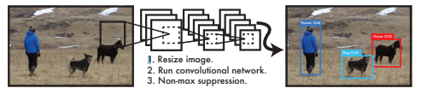
YOLO: Real-Time Object_Detection
base network runs at 45 frames per second (up to 155)
pretrained weights on COCO dataset
Weights: "yolov3-tiny.weight"
It was decided to use the TINY version of the weights and the configuration in order to cope with the bridge calculation limits
contains class “person” and it’s easy to use

Slide 31
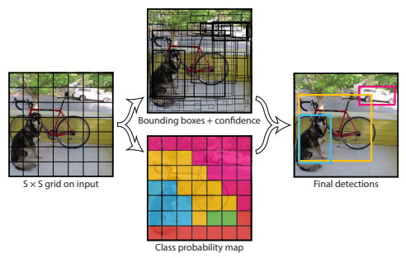
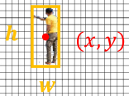
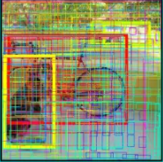
Network uses features from the entire image to predict each bounding box
Image splitted into an SxS grid
Pr(Classi|Object) ∗ Pr(Object) class-specific confidence scores for each box
Non-Max Suppression
locating
classifying

Slide 32
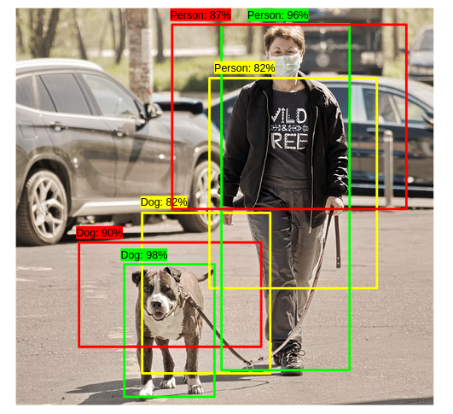
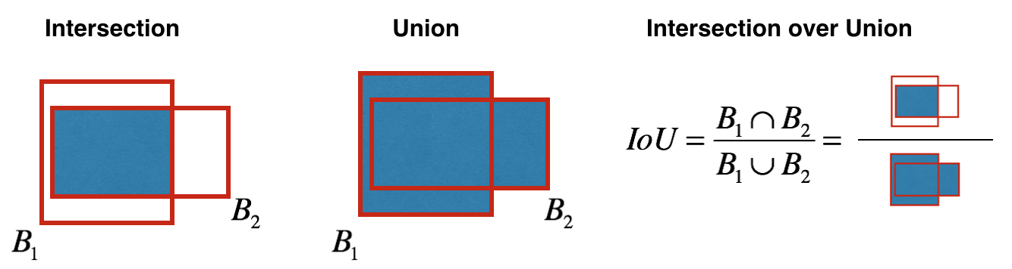
Non max-suppression
select the bounding box with the highest objectiveness score
remove all the other boxes with high overlap

Slide 33
Our Algorithm - YOLO Pseudo Code
findObject(boxes,labels,threshold)
load image
create blob from image
net.setInput(blob)
outputs = net.forward()
boxes , labels, scores = array(), array(),array()
iterate over number of boxes
classID = argmax(scores)
confidence = scores[classID]
take only boxes with
confidence > NMS_threshold
#in our specific case
iterate over all possible classes & boxes
if class associated with box == “person”
!!send alarm!!

Slide 34
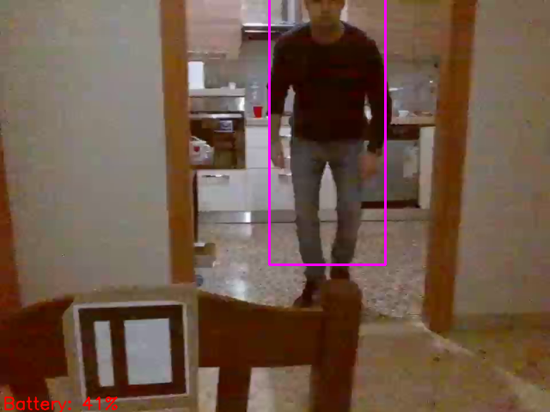
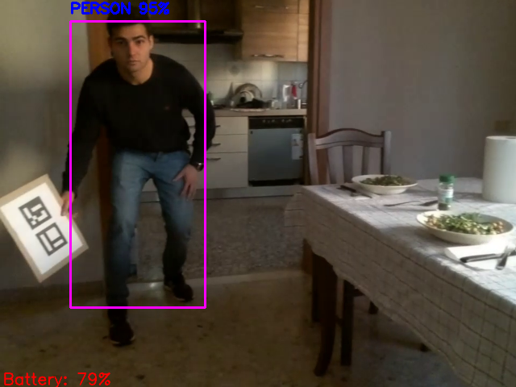
YOLO examples

Slide 35
DEMO VIDEO

Slide 36
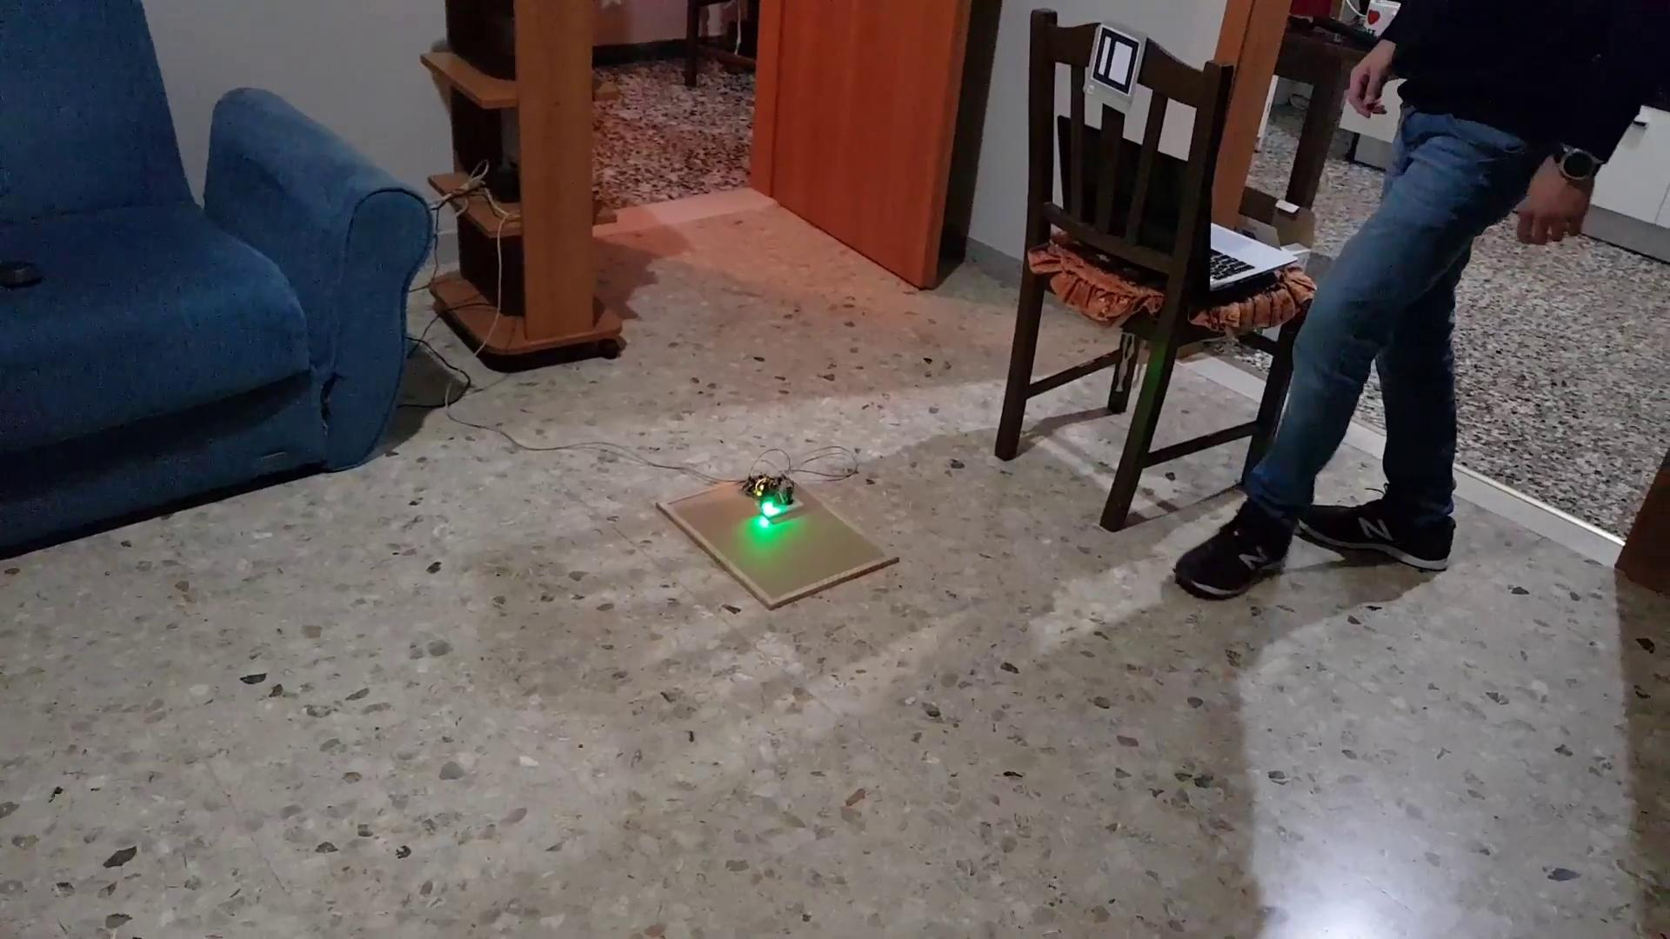

Slide 37
Thanks for your attention!
Questions?

